Slide 1
College of Criminal Justice
FY 2024 Planning and Budget Meeting

Slide 2
College of Criminal Justice
Academic / Division Departments
Criminal Justice & Criminology
Forensic Science
Security Studies
Victim Studies
Centers
Bill Blackwood LEMIT
Center for Intelligence & Crime Analysis
CMIT
Crime Victims’ Institute
CRIMES
Institute for For. Res. Trng. & Innovation
Institute for Homeland Security

Slide 3
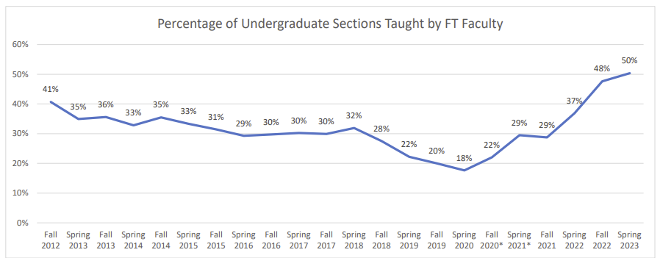
FY 2023 Accomplishments
Priority 1: Prioritize Student Success and Student Access
(A) Gladys Porter High School
Multiple visits annually have netted us 22 accepted and 9 committed students from the poorest ISD and most diverse in the state. This is the first year we have had any applicants from the school.
(A) Doubling of 100% Online students over eight years continues support for PDL.
Open Educational Resources facilitate access.
As does online delivery mode.
(S) At or above the institutional mean in Spring to Fall persistence.
(S) Highest persistence rate for 1st time freshmen and x-fer students (Fall ‘22 cohort).
Highest retention rates for Fall ‘20 cohort; rate went up for ‘21 cohort.

Slide 4
FY 2023 Accomplishments
Priority 2: Embody a Culture of Excellence
Bree Boppre, Department of Victim Studies:
2022 ACJS Ken Peak Innovative Teaching Award; 2022 ASC, Div. Fem. Crim, New Scholar Award.
Shelly Clevenger, Department of Victim Studies:
2023 ACJS, Mentor Award, 2022 ASC, Div. Fem. Crim., Distinguished Scholar Award.
Jason Ingram, Department of Criminal Justice and Criminology:
Academy of Criminal Justice Sciences, Outstanding Mentor Award.
Tim Kalafut, Department of Forensic Science:
Journal of Forensic Sciences, Top Cited Article for 2021-2022.
Peter Lehmann, Department of Criminal Justice & Criminology:
Academy of Criminal Justice Sciences, New Scholar Award.
Danielle Rudes, Department of Criminal Justice & Criminology:
Academy of Criminal Justice Sciences, Book Award, “Surviving Solitary.”
Patents Jorn Yu: AI a) distinguishing hemp and marijuana, b) CSI with latent prints.
PDL effort is paying off with ≈2,400 SCH (9.3%) ≈1,250 POT (55%).

Slide 5
FY 2023 Accomplishments
Priority 3: Elevate the Reputation and Visibility of SHSU
Legislative expansion of Forensic Science M.S. program.
Institute for Homeland Security:
Very active Advisory Board with partners from the four critical infrastructure areas tasked to them.
Conduct bi-annual meetings with participants from 50 public and private sector organizations to inform their strategic objectives.
PDL
Professors of Practice
Katherine Parsley, Former sitting State District Court Judge and Executive Director of Crimestoppers.
Edward Gallagher, Former Assistant US Attorney, FBI agent, municipal police officer.
CJTexas.org.
CMIT facilitated professional development for participants from 40 US states, several Mexican States, Colombia, The Czech Republic, Ecuador, and Morocco. Much of this was sponsored by the US State Department, greatly increasing our visibility both nationally and internationally.

Slide 6
FY 2023 Accomplishments
Priority 4: Expand and Elevate our Service to the State and Beyond
The Center for Intelligence and Crime Analysis was established to build out tool kits that will increase efficiency and effectiveness in deployment of their resources.
CMIT: 160,000+ contact hours, ≈ 9,000 participants, through ≈ 200 programs; developing Jail needs assessment tool.
CVI: 6 technical reports (≈1k downloads) 9 Fact Sheets (2 Español; [1.5k downloads]), 4 newsletters (≈450 downloads) , 2 “CVI Talks,” 2 seminars (120 participants).
LEMIT: 80,000+ contact hours to ≈ 2,500 participants. Incorporated Advanced Law Enforcement Rapid Response Training (ALERTT; [soon mandatory?]) in direct response to the Uvalde tragedy; Model policies. Duty To Intervene.
The IHS developed 11 professional skills development courses that will lead to stackable micro-credentials, commissioned 24 research and practice briefs informing critical infrastructure protection strategies, and was selected as the primary research organization for the Governor’s Private Sector Advisory Council.
TCOLE-initiated peace officer task analysis—the first such undertaking since the 1970’s. Dovetails nicely with our distillation of learning objectives for the courses that comprise our Premium Distance Learning effort.

Slide 7
Budget Request
#1 Budget Priority | Senior Director of Innovation and Strategy.
Aligned with Strategic Priority Goal | Strategic Priority 1 Goal 2: Academic agility.
Amount Requested | $200,500
Frequency of Need | Recurring.
Opportunity Statement | The confluence of: a) the expansion of the IHS (and its need for certificate programming), b) the establishment of the CICA (and its positioning to strengthen our service to the state), c) the success of our PDL and CJTexas.org efforts, and d) the departure of TDCJ provide a once-in-a generation opportunity to synergize and grow.
Risk Statement | The failure to leverage this opportunity through effective coordination, oversight, management, strategizing, and implementation will stymie growth in key areas including development of: a) market-driven academic programs supported by flexible scheduling and modality, b) micro-credentials that provide academic credit, and c) pathways from professional competencies to academic credit.

Slide 8
Supportive Data

Slide 9
Budget Request
#2 Budget Priority | Faculty line for the Department of Victim Studies.
Aligned with Strategic Priority Goal | Strategic Priority 1 Goal 1: Recruit, retain, graduate, and empower students to drive sustainable growth.
Amount Requested | $105,226
Frequency of Need | Recurring.
Opportunity Statement | The new line will provide us with an opportunity to meet the growing demands of the Victim Studies programs, which have seen a five-fold increase in the number of semester credit hours delivered over the past decade.
Risk Statement | Not having adequate faculty resources in place will limit continued growth opportunities.
#2 Budget Priority
What is the request?

Slide 10
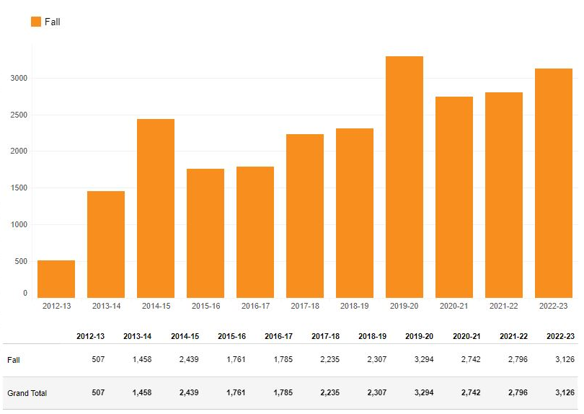
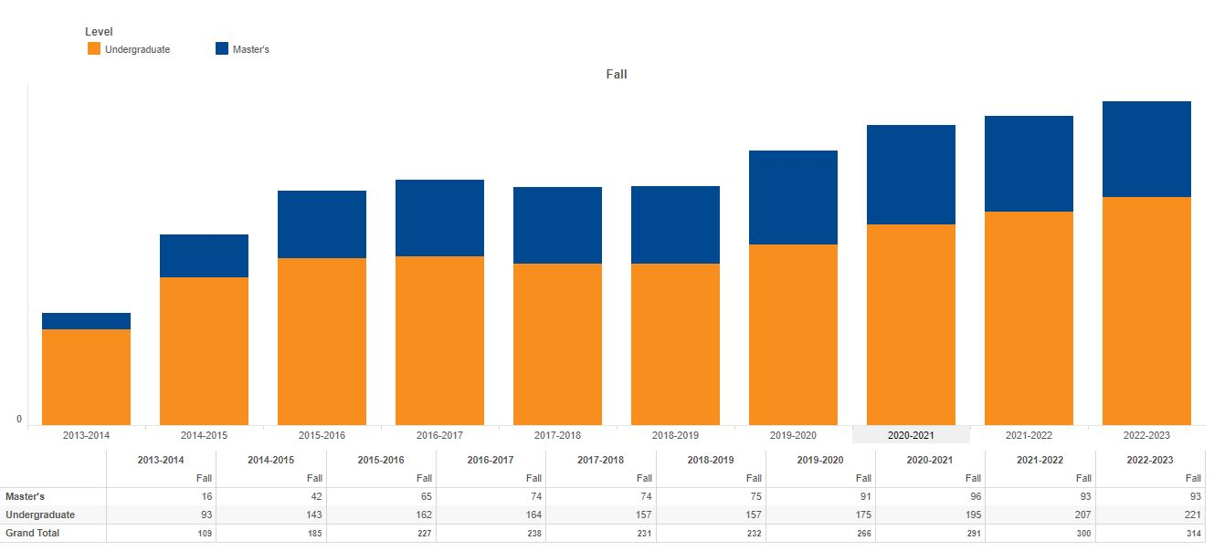
Supportive Data

Slide 11
Budget Request
#3 Budget Priority | Two post-docs (chem. & bio.) for Dept. of Forensic Science.
Aligned with Strategic Priority Goal | Strategic Priority 1 Goal 1: Recruit, retain, graduate, and empower students to drive sustainable growth.
Amount Requested | $182,432
Frequency of Need | Recurring.
Opportunity Statement | FS students have increased 53% in 9 years. There has been an eight-fold increase in SCH, owing mostly to growth in the minor. Post-docs facilitate: a) instructional delivery at a lower cost than tenured/tenure-track faculty, b) expanded research capacity, and c) equipment maintenance/repairs at a lower cost than reliance on technicians.
Risk Statement | The FS accrediting body, FEPAC, cautioned the department that they lacked the capacity to provide the requisite level of quality instruction and research supervision.

Slide 12
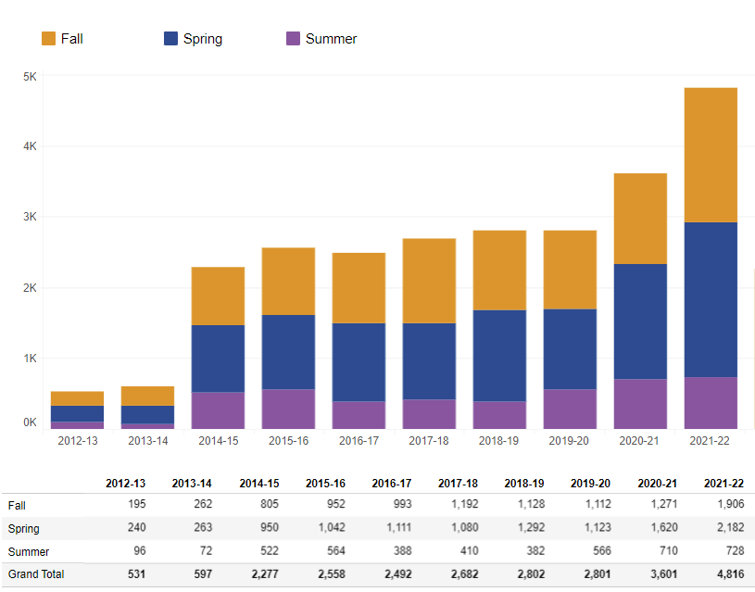
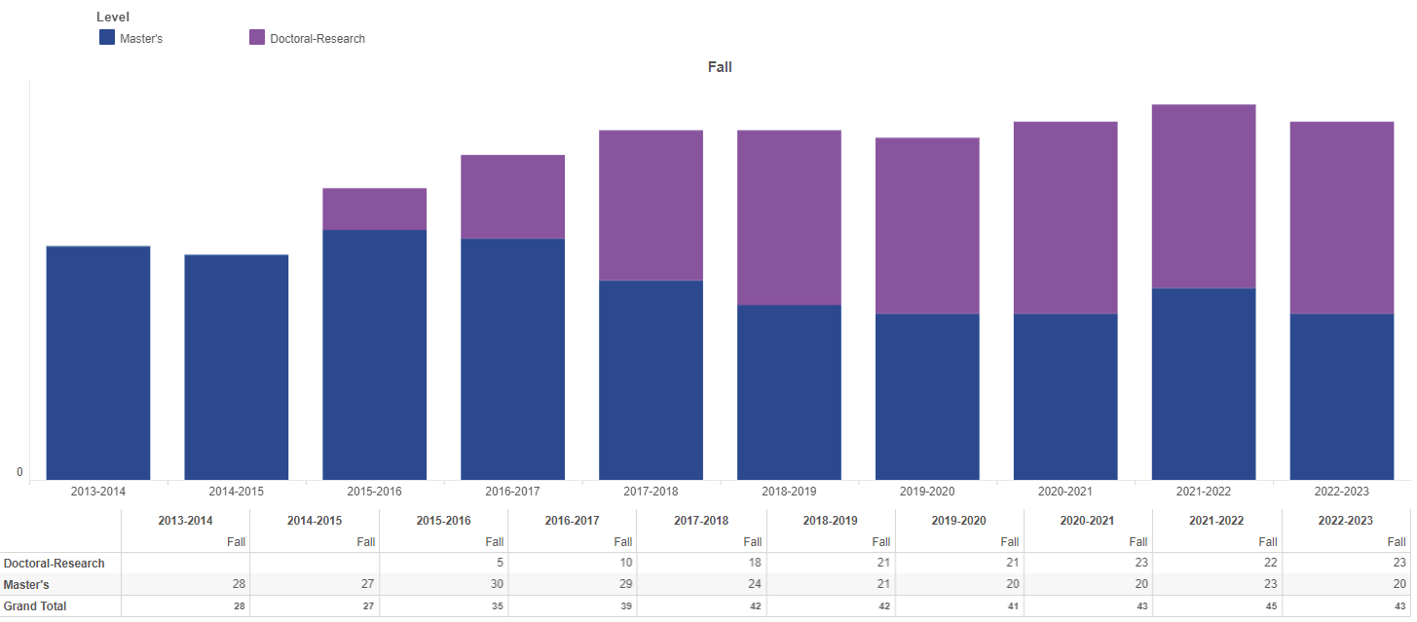
Supportive Data

Slide 13
Budget Request
#4 Budget Priority | Faculty and staff travel for professional development
Aligned with Strategic Priority Goal | Strategic Priority 2 Goal 3: Provide a supportive, empowering, and culturally responsive workplace.
Amount Requested | $69,000
Frequency of Need | Recurring.
Opportunity Statement | This $500 increase per faculty member, the first increase in over a decade, will remediate a disparity in such funding across colleges and provide professional development opportunities for staff.
Risk Statement | In addition to undermining recruiting efforts, inadequate funding of travel to professional conferences impairs scholarly engagement and the development of skills and abilities essential to cultivating a culture of excellence.

Slide 14
Budget Request
#5 Budget Priority | Additional graduate assistantship lines.
Aligned with Strategic Priority Goal | Strategic Priority 1 Goal 1: Recruit, retain, graduate, and empower students to drive sustainable growth.
Amount Requested | $223,000
Frequency of Need | Recurring (1st of three-year phase-in to bring PhD cohorts to 9 and MA cohorts to 8).
Opportunity Statement | The increase in the number of tenure-track faculty members in the Department of Criminal Justice and Criminology expands capacity to take on more students at the MA and PhD levels thereby leveraging existing faculty resources.
Risk Statement | Without additional MA and PhD students, we risk small-class exceptions and will lack graduate assistantships to support faculty.

Slide 15
Summary of Budget Requests
Senior Director of Innovation and Strategy------------$200,500
Faculty line for Victim Studies-----------------------------$105,226
Two post-docs (bio & chem) for Forensic Science---$182,432
Faculty & staff travel for professional development--$ 69,000
Graduate assistantship lines-------------------------------$223,000
*Total Amount Requested – $ 780,158

Slide 16
Self-funded New Initiatives
None

Slide 17
Prospective “Big Ideas”
Invigorate our relationship with the Royal Thai Police to capitalize on opportunities for our faculty and students by leveraging our strengths:
Applied nature of our work that provides direct benefits to the field.
Substantial international presence.
Close ties with the agency.
Offer professional development content in Spanish
Builds on existing programs and capacity.
Leverages our international presence.
Advances our HSI status.
Stands to improve public safety and quality of life in Texas because of the spillover of crime and disorder from Central and South America.

Slide 18
Questions?

